Slide 1

Notes:
Searching the web
Two 45-minute lessons. Lesson 1 slides 2–9. Lesson 2 slides 10–18. Preparation: display, notebooks, approved browser access or use offline cards on slide 7. The fictional page cards on slide 14 support the offline role-play. Pupils can copy cards into notebooks. Use model answers on slide 16 after discussion.
Teaching content:
Year 5 Computing
Term 1 Week 10
Lesson 1: Searching the web
Lesson 2: How search engines work
Sources: Oxford International Primary Computing Student Book 5, printed pp.20–25 (uploaded source). Approved Week 10 lesson plan: https://rayjoshuaa.github.io/ and https://rayjoshuaa.github.io/lesson-content-y5.js (y5-t1-w10). Visuals: AI-generated classroom illustrations. Fictional page cards and example results are teaching models.

Slide 2
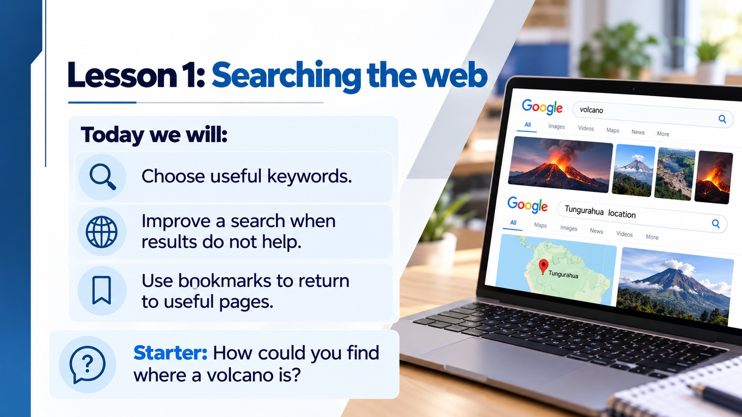
Notes:
Lesson 1: Searching the web
Teaching content:
Today we will:
Choose useful keywords.
Improve a search when results do not help.
Use bookmarks to return to useful pages.
Starter: How could you find where a volcano is?
Sources: Oxford International Primary Computing Student Book 5, printed pp.20–25 (uploaded source). Approved Week 10 lesson plan: https://rayjoshuaa.github.io/ and https://rayjoshuaa.github.io/lesson-content-y5.js (y5-t1-w10). Visuals: AI-generated classroom illustrations. Fictional page cards and example results are teaching models.

Slide 3

Notes:
Four habits for a useful search
Teaching content:
1. Choose clear keywords.
2. Use the teacher-approved search tool.
3. Bookmark useful pages.
4. Change the query and try again.
Sources: Oxford International Primary Computing Student Book 5, printed pp.20–25 (uploaded source). Approved Week 10 lesson plan: https://rayjoshuaa.github.io/ and https://rayjoshuaa.github.io/lesson-content-y5.js (y5-t1-w10). Visuals: AI-generated classroom illustrations. Fictional page cards and example results are teaching models.

Slide 4
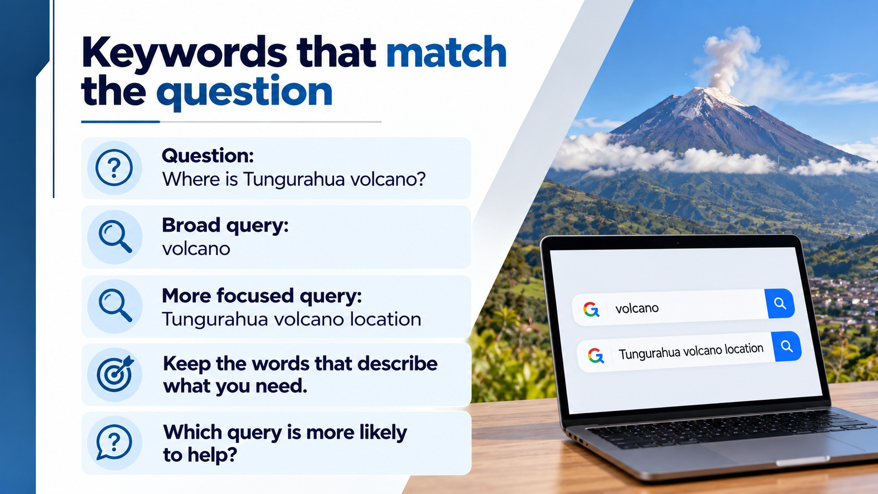
Notes:
Keywords that match the question
Teaching content:
Question: Where is Tungurahua volcano?
Broad query: volcano
More focused query: Tungurahua volcano location
Keep the words that describe what you need.
Which query is more likely to help?
Sources: Oxford International Primary Computing Student Book 5, printed pp.20–25 (uploaded source). Approved Week 10 lesson plan: https://rayjoshuaa.github.io/ and https://rayjoshuaa.github.io/lesson-content-y5.js (y5-t1-w10). Visuals: AI-generated classroom illustrations. Fictional page cards and example results are teaching models.

Slide 5

Notes:
A useful search tool
Teaching content:
Use the search tool your teacher approves.
Some tools offer results designed for children.
Read the title and description before opening a result.
If something worries you, stop and ask an adult.
Sources: Oxford International Primary Computing Student Book 5, printed pp.20–25 (uploaded source). Approved Week 10 lesson plan: https://rayjoshuaa.github.io/ and https://rayjoshuaa.github.io/lesson-content-y5.js (y5-t1-w10). Visuals: AI-generated classroom illustrations. Fictional page cards and example results are teaching models.

Slide 6
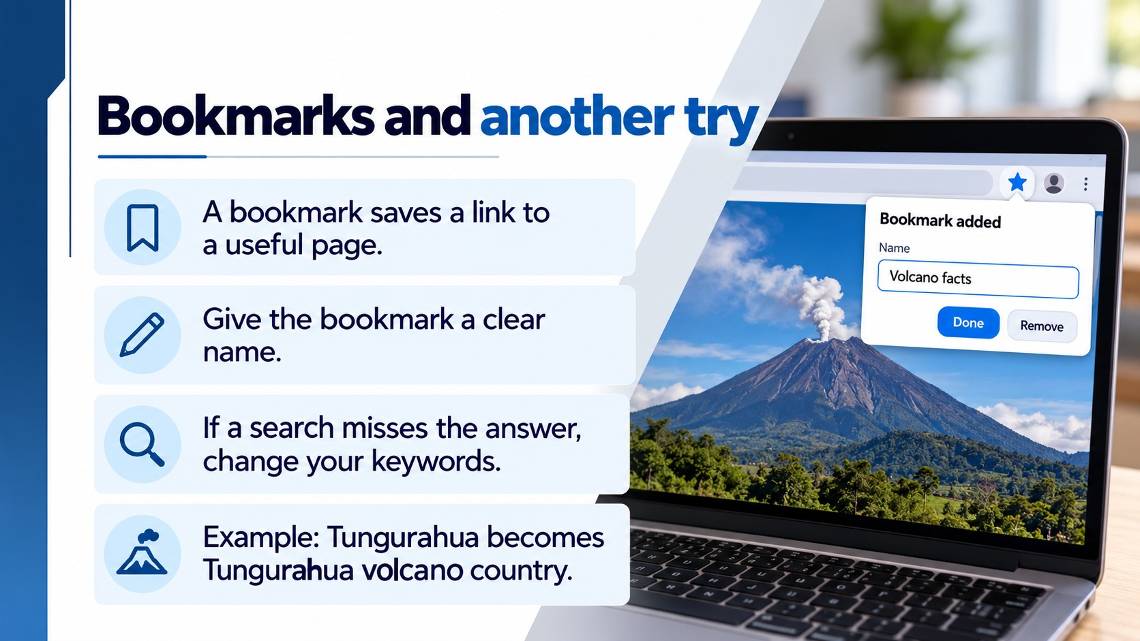
Notes:
Bookmarks and another try
Teaching content:
A bookmark saves a link to a useful page.
Give the bookmark a clear name.
If a search misses the answer, change your keywords.
Example: Tungurahua becomes Tungurahua volcano country.
Sources: Oxford International Primary Computing Student Book 5, printed pp.20–25 (uploaded source). Approved Week 10 lesson plan: https://rayjoshuaa.github.io/ and https://rayjoshuaa.github.io/lesson-content-y5.js (y5-t1-w10). Visuals: AI-generated classroom illustrations. Fictional page cards and example results are teaching models.

Slide 7
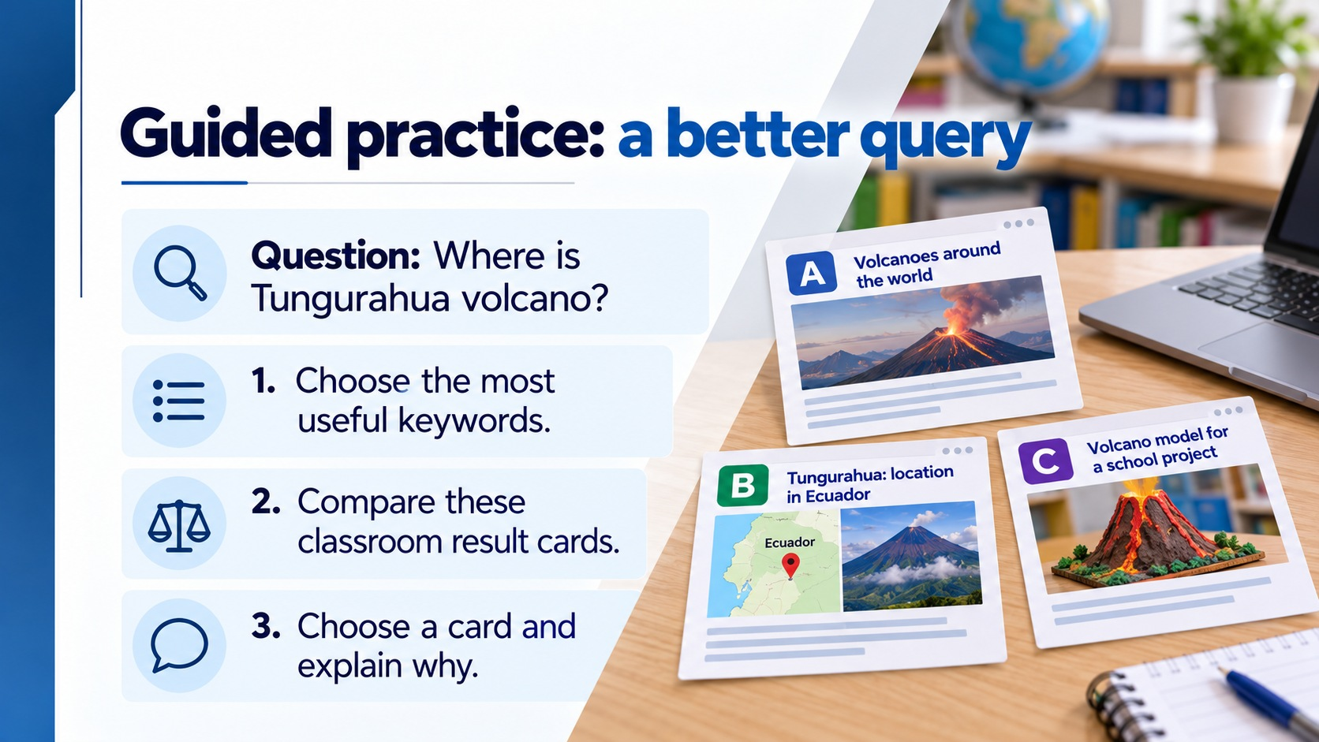
Notes:
Guided practice: a better query
Suggested answer: Tungurahua volcano location. Card B best answers the location question. Cards are prepared fictional summaries, not live search results. Model query refinement aloud.
Teaching content:
Question: Where is Tungurahua volcano?
1. Choose the most useful keywords.
2. Compare these classroom result cards.
3. Choose a card and explain why.
A: Volcanoes around the world
B: Tungurahua: location in Ecuador
C: Volcano model for a school project
Sources: Oxford International Primary Computing Student Book 5, printed pp.20–25 (uploaded source). Approved Week 10 lesson plan: https://rayjoshuaa.github.io/ and https://rayjoshuaa.github.io/lesson-content-y5.js (y5-t1-w10). Visuals: AI-generated classroom illustrations. Fictional page cards and example results are teaching models.

Slide 8
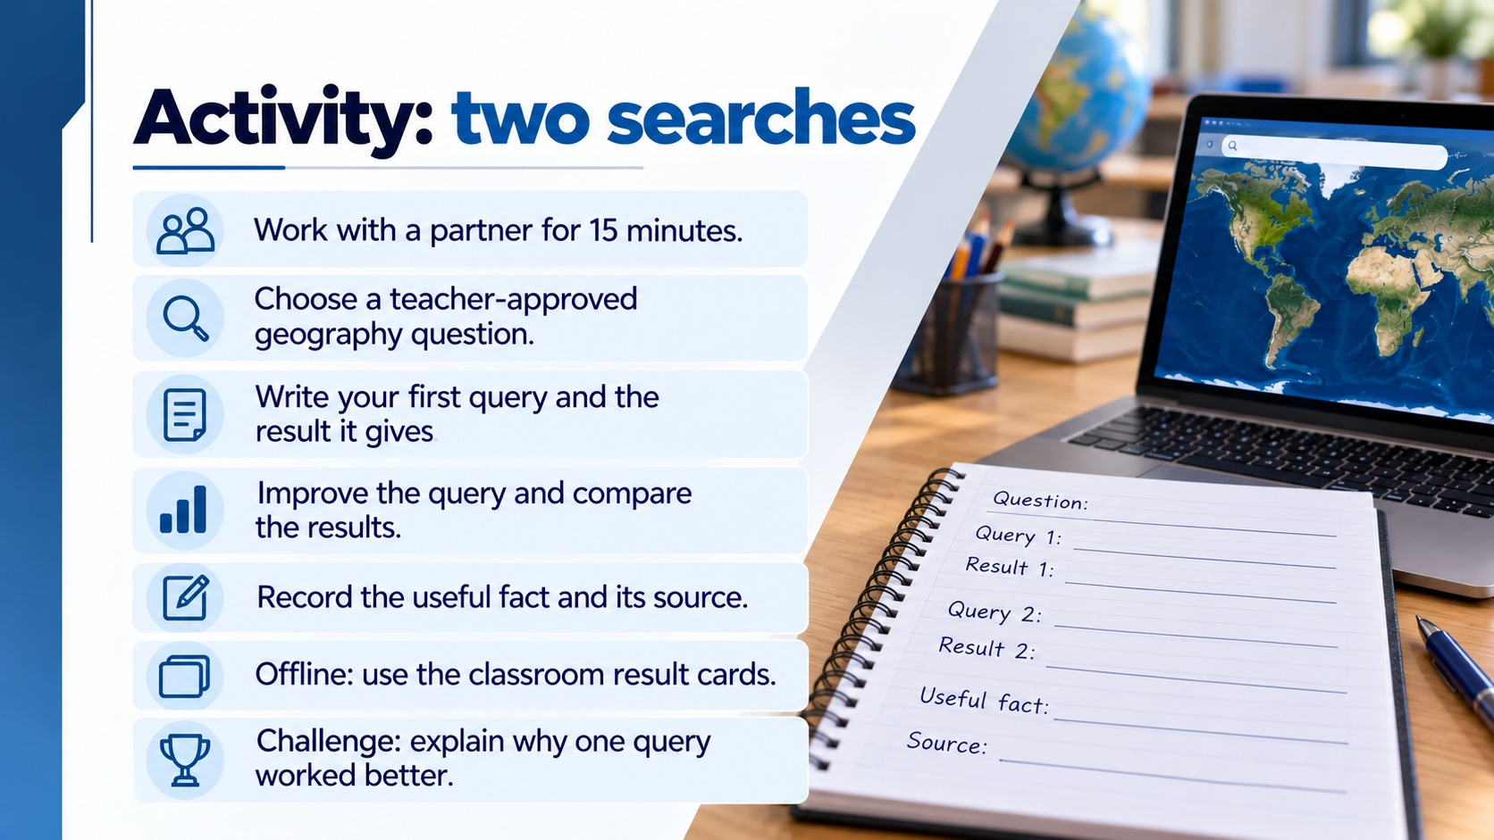
Notes:
Activity: two searches
Lesson 1 timings: starter/objectives 5, habits 5, keywords 6, tool choice 4, bookmarks 4, guided example 6, independent practice 12, review 3. Activity slide says 15 minutes including 12 minutes work and 3 minutes sharing/review. Offline: ask pupils to compare volcano, Tungurahua and Tungurahua location against slide 7 cards. Record which card each query might retrieve and explain which answer is most relevant. Support: supply query words. Extension: compare two query choices and explain limitations.
Teaching content:
Work with a partner for 15 minutes.
Choose a teacher-approved geography question.
Write your first query and the result it gives.
Improve the query and compare the results.
Record the useful fact and its source.
Offline: use the classroom result cards.
Challenge: explain why one query worked better.
Sources: Oxford International Primary Computing Student Book 5, printed pp.20–25 (uploaded source). Approved Week 10 lesson plan: https://rayjoshuaa.github.io/ and https://rayjoshuaa.github.io/lesson-content-y5.js (y5-t1-w10). Visuals: AI-generated classroom illustrations. Fictional page cards and example results are teaching models.

Slide 9
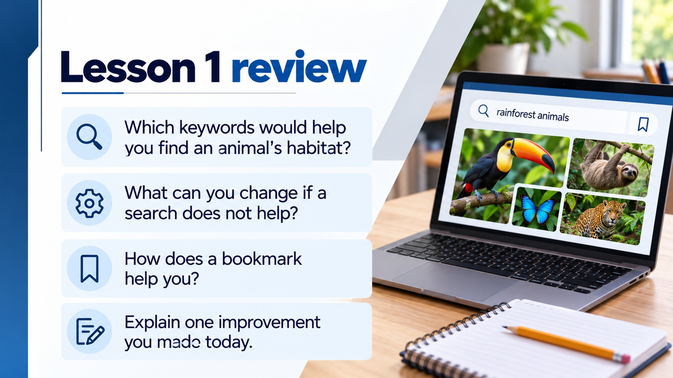
Notes:
Lesson 1 review
Expected responses: animal name plus habitat; change/add more specific keywords; bookmark stores a link for quick return. Assess one spoken explanation per pair.
Teaching content:
Which keywords would help you find an animal's habitat?
What can you change if a search does not help?
How does a bookmark help you?
Explain one improvement you made today.
Sources: Oxford International Primary Computing Student Book 5, printed pp.20–25 (uploaded source). Approved Week 10 lesson plan: https://rayjoshuaa.github.io/ and https://rayjoshuaa.github.io/lesson-content-y5.js (y5-t1-w10). Visuals: AI-generated classroom illustrations. Fictional page cards and example results are teaching models.

Slide 10
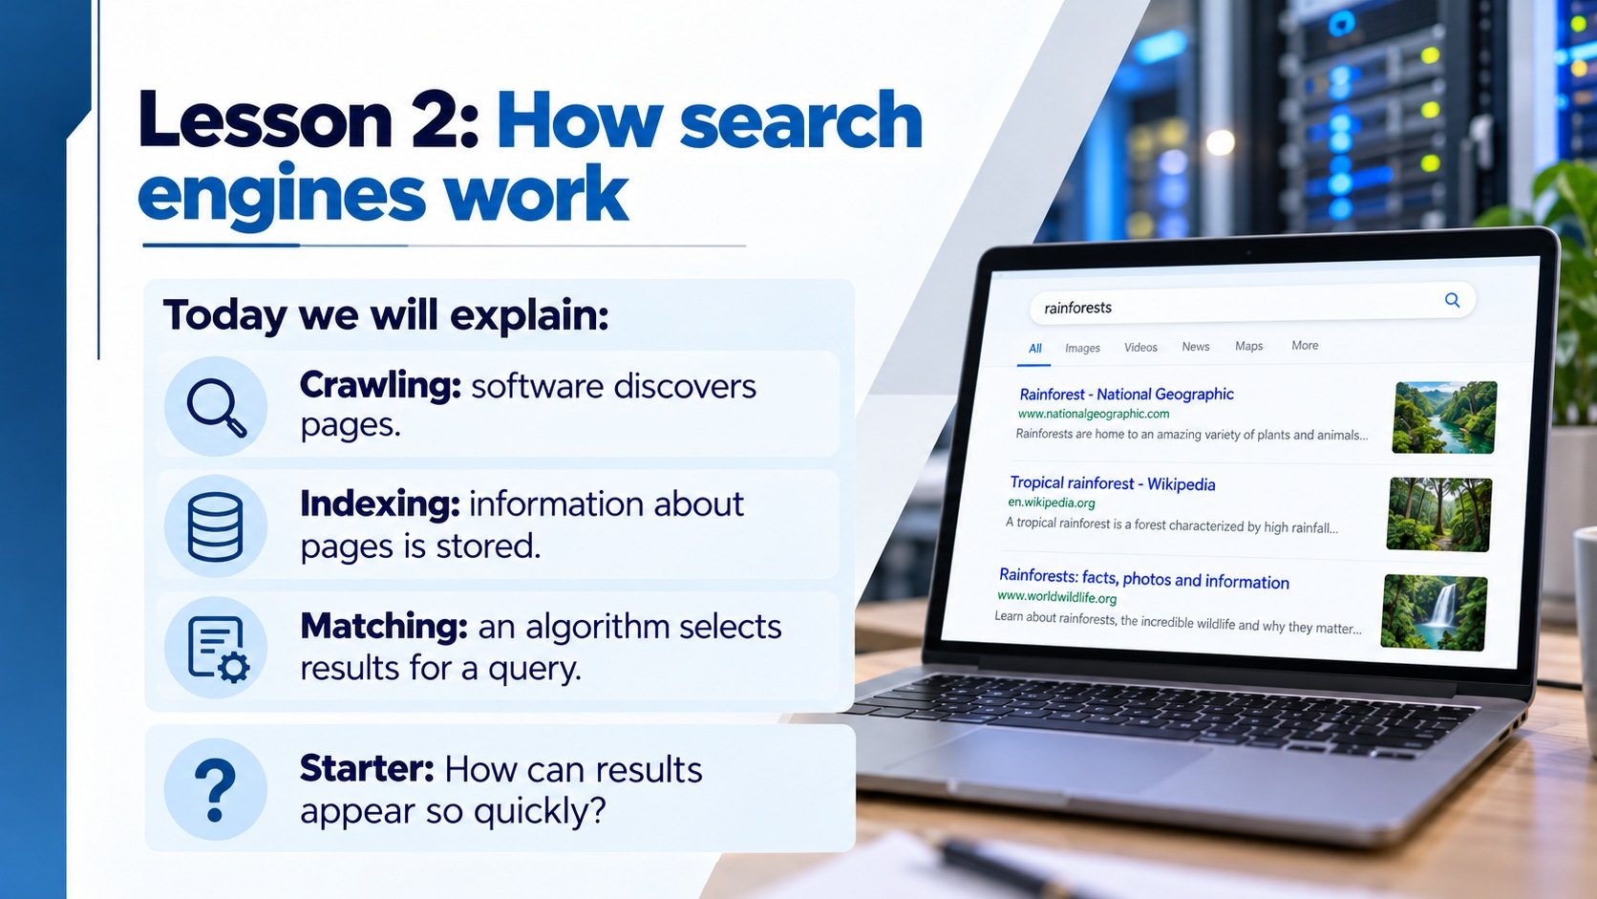
Notes:
Lesson 2: How search engines work
Lesson 2 timings: starter 5, crawlers 6, index 6, matching 6, page-card demonstration 5, role-play 15, exit review 2. Slide 16 supplies feedback during the final part of role-play. Slide 18 is optional closing recap.
Teaching content:
Today we will explain:
Crawling: software discovers pages.
Indexing: information about pages is stored.
Matching: an algorithm selects results for a query.
Starter: How can results appear so quickly?
Sources: Oxford International Primary Computing Student Book 5, printed pp.20–25 (uploaded source). Approved Week 10 lesson plan: https://rayjoshuaa.github.io/ and https://rayjoshuaa.github.io/lesson-content-y5.js (y5-t1-w10). Visuals: AI-generated classroom illustrations. Fictional page cards and example results are teaching models.

Slide 11

Notes:
Web crawlers
Teaching content:
A crawler is software, sometimes called a spider.
It discovers accessible web pages and follows links.
It collects information about the pages it visits.
Some pages are unavailable or never reach the index.
Sources: Oxford International Primary Computing Student Book 5, printed pp.20–25 (uploaded source). Approved Week 10 lesson plan: https://rayjoshuaa.github.io/ and https://rayjoshuaa.github.io/lesson-content-y5.js (y5-t1-w10). Visuals: AI-generated classroom illustrations. Fictional page cards and example results are teaching models.

Slide 12

Notes:
The search index
Teaching content:
The index stores information about discovered pages.
Think of an organised catalogue.
A search engine can look in its index quickly.
It does not read the whole web again for every query.
Sources: Oxford International Primary Computing Student Book 5, printed pp.20–25 (uploaded source). Approved Week 10 lesson plan: https://rayjoshuaa.github.io/ and https://rayjoshuaa.github.io/lesson-content-y5.js (y5-t1-w10). Visuals: AI-generated classroom illustrations. Fictional page cards and example results are teaching models.

Slide 13
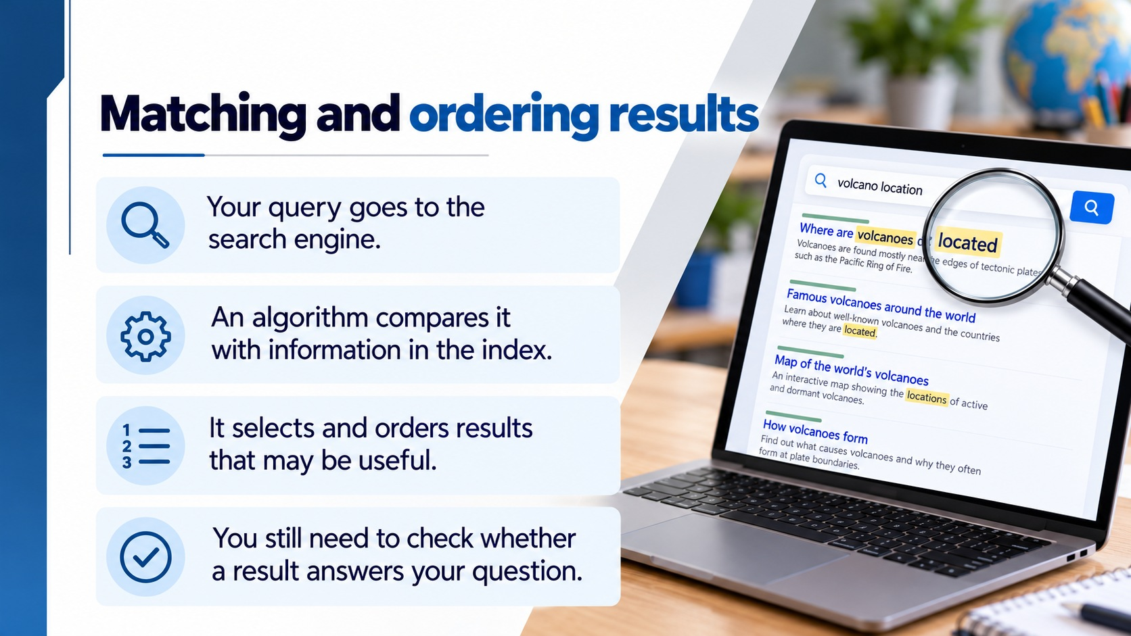
Notes:
Matching and ordering results
Teaching content:
Your query goes to the search engine.
An algorithm compares it with information in the index.
It selects and orders results that may be useful.
You still need to check whether a result answers your question.
Sources: Oxford International Primary Computing Student Book 5, printed pp.20–25 (uploaded source). Approved Week 10 lesson plan: https://rayjoshuaa.github.io/ and https://rayjoshuaa.github.io/lesson-content-y5.js (y5-t1-w10). Visuals: AI-generated classroom illustrations. Fictional page cards and example results are teaching models.

Slide 14
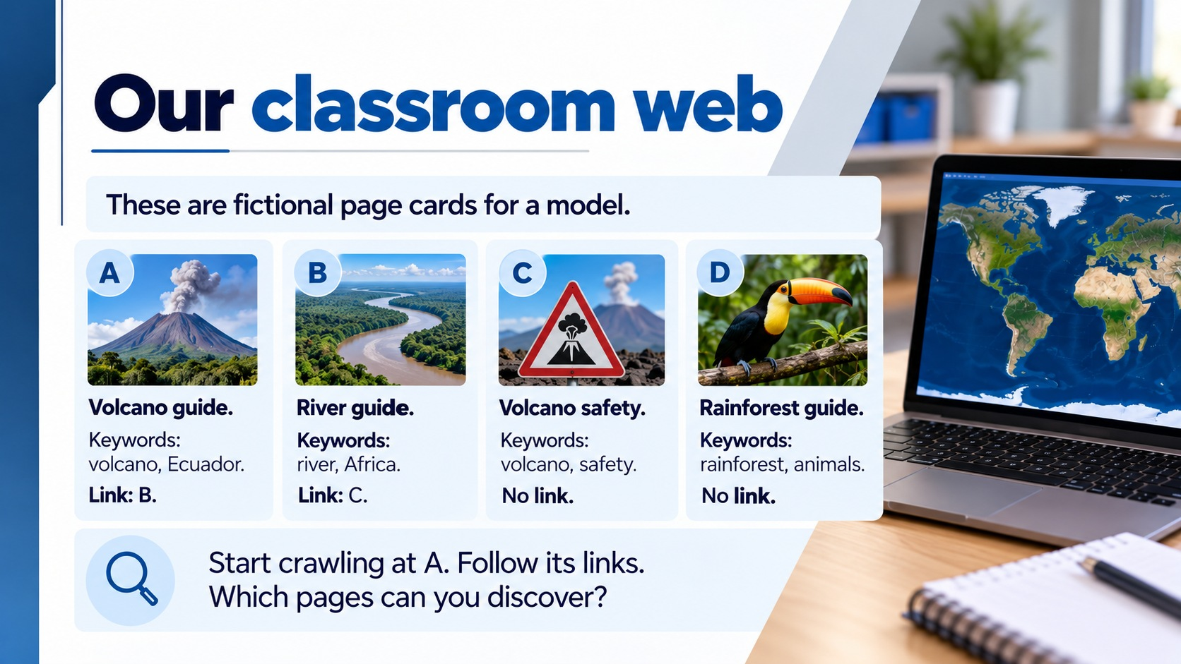
Notes:
Our classroom web
Read aloud and let pupils copy the four short cards. Demonstrate starting at A and following A to B then B to C. D has no incoming link in this small model. This models discovery limits, not a complete real search algorithm.
Teaching content:
These are fictional page cards for a model.
A: Volcano guide. Keywords: volcano, Ecuador. Link: B.
B: River guide. Keywords: river, Africa. Link: C.
C: Volcano safety. Keywords: volcano, safety. No link.
D: Rainforest guide. Keywords: rainforest, animals. No link.
Start crawling at A. Follow its links.
Which pages can you discover?
Sources: Oxford International Primary Computing Student Book 5, printed pp.20–25 (uploaded source). Approved Week 10 lesson plan: https://rayjoshuaa.github.io/ and https://rayjoshuaa.github.io/lesson-content-y5.js (y5-t1-w10). Visuals: AI-generated classroom illustrations. Fictional page cards and example results are teaching models.

Slide 15
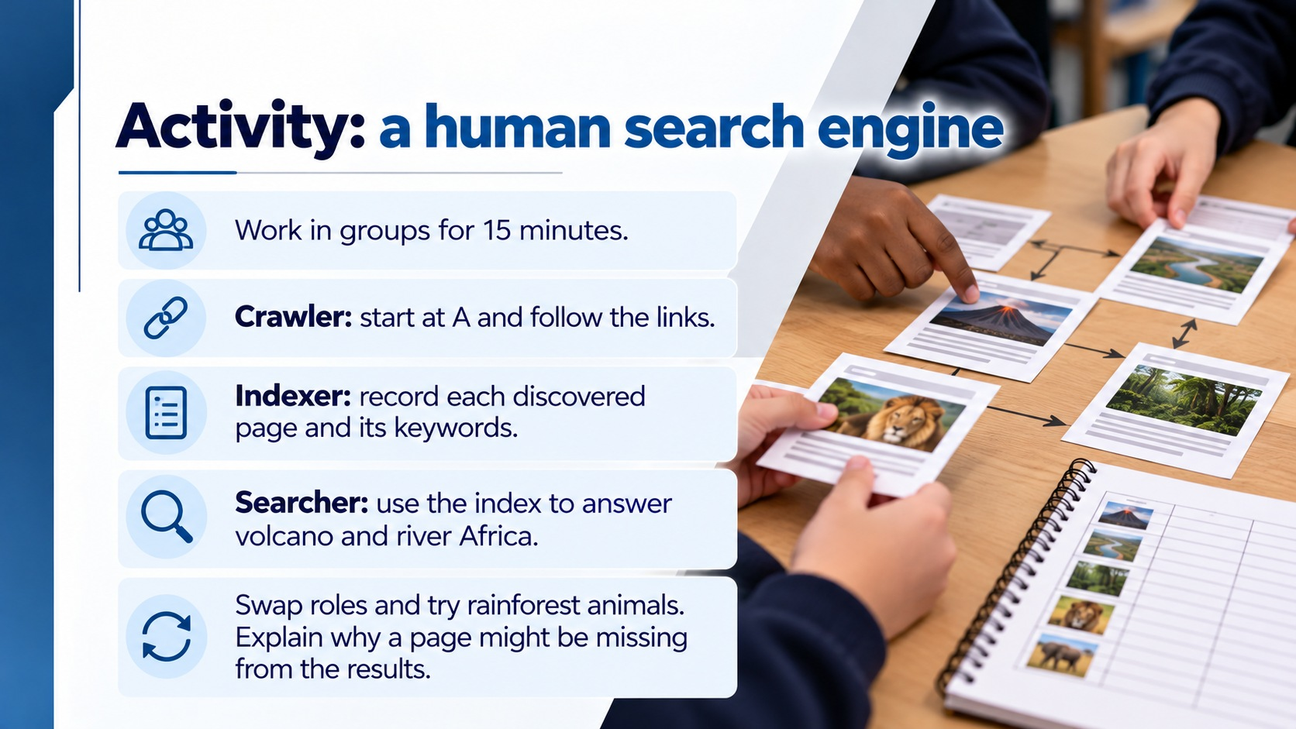
Notes:
Activity: a human search engine
Use three roles per group. Crawler reads discovered page keywords. Indexer records A/B/C. Searcher checks query words against index. Query volcano returns A and C; river Africa returns B; rainforest animals finds no indexed card. Discuss why D is absent. Model simplification: real systems use multiple discovery methods and many ranking signals.
Teaching content:
Work in groups for 15 minutes.
Crawler: start at A and follow the links.
Indexer: record each discovered page and its keywords.
Searcher: use the index to answer volcano and river Africa.
Swap roles and try rainforest animals.
Explain why a page might be missing from the results.
Sources: Oxford International Primary Computing Student Book 5, printed pp.20–25 (uploaded source). Approved Week 10 lesson plan: https://rayjoshuaa.github.io/ and https://rayjoshuaa.github.io/lesson-content-y5.js (y5-t1-w10). Visuals: AI-generated classroom illustrations. Fictional page cards and example results are teaching models.

Slide 16
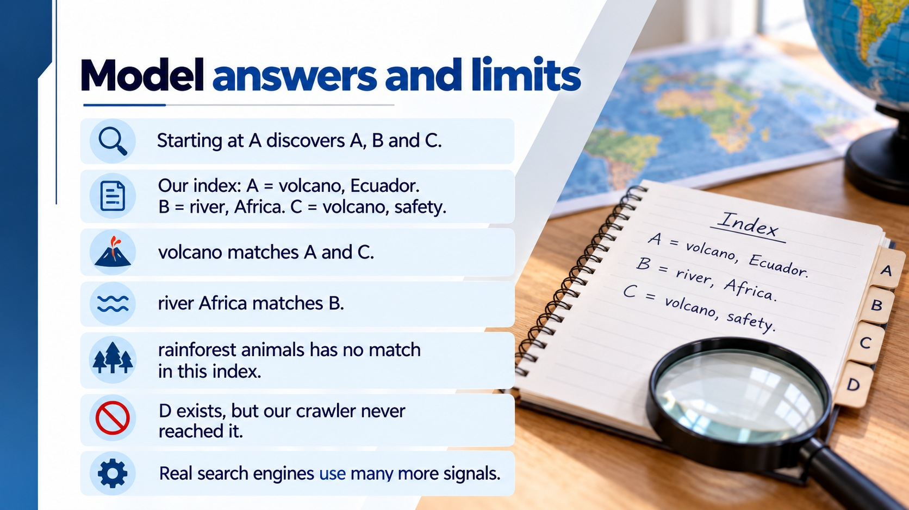
Notes:
Model answers and limits
Teaching content:
Starting at A discovers A, B and C.
Our index: A = volcano, Ecuador. B = river, Africa. C = volcano, safety.
volcano matches A and C.
river Africa matches B.
rainforest animals has no match in this index.
D exists, but our crawler never reached it.
Real search engines use many more signals.
Sources: Oxford International Primary Computing Student Book 5, printed pp.20–25 (uploaded source). Approved Week 10 lesson plan: https://rayjoshuaa.github.io/ and https://rayjoshuaa.github.io/lesson-content-y5.js (y5-t1-w10). Visuals: AI-generated classroom illustrations. Fictional page cards and example results are teaching models.

Slide 17
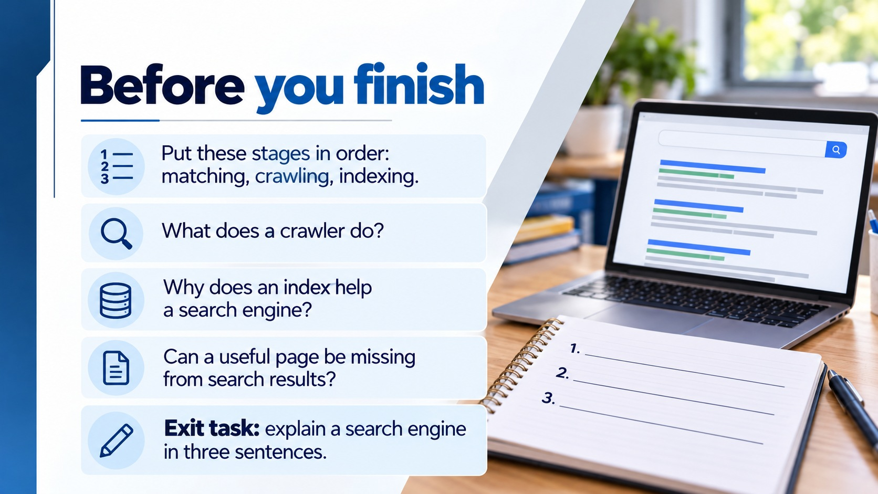
Notes:
Before you finish
Answers: crawling, indexing, matching. Crawler software discovers accessible pages and follows links. Index stores page information for quick search. Yes: discovery/access/indexing limits can omit a page. Collect three-sentence explanation. Support sentence stems: A crawler... The index... When I search...
Teaching content:
1. Put these stages in order: matching, crawling, indexing.
2. What does a crawler do?
3. Why does an index help a search engine?
4. Can a useful page be missing from search results?
Exit task: explain a search engine in three sentences.
Sources: Oxford International Primary Computing Student Book 5, printed pp.20–25 (uploaded source). Approved Week 10 lesson plan: https://rayjoshuaa.github.io/ and https://rayjoshuaa.github.io/lesson-content-y5.js (y5-t1-w10). Visuals: AI-generated classroom illustrations. Fictional page cards and example results are teaching models.

Slide 18

Notes:
Week 10 recap
Teaching content:
Useful searches start with clear keywords.
Refining a query can improve the results.
Bookmarks help you return to useful pages.
Crawlers discover pages and indexes store information.
Algorithms match and order results.
A search index does not contain every web page.
Sources: Oxford International Primary Computing Student Book 5, printed pp.20–25 (uploaded source). Approved Week 10 lesson plan: https://rayjoshuaa.github.io/ and https://rayjoshuaa.github.io/lesson-content-y5.js (y5-t1-w10). Visuals: AI-generated classroom illustrations. Fictional page cards and example results are teaching models.

